Slide 1
Copilot AI-Assisted Coding Lessons Learned
Akram Zaki, Jul-2025
https://github.com/akram0zaki/GithubCopilotDemo

Slide 2

Why GitHub Copilot, and why now?
Building Faster, Clearing Debt, Creating the Future
Notes:
There are many answers to these questions but what stands out for me is that it allows me to build software much faster, and it enables me to comfortably step beyond my comfort zone.

Slide 3
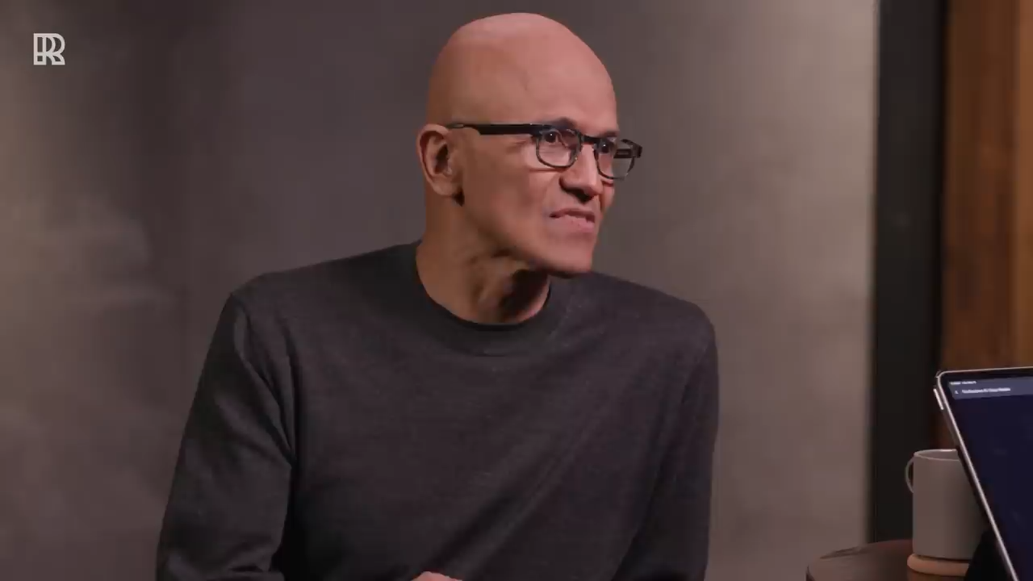
Satya Nadella on AI + Developer Productivity (1 min) https://bit.ly/why-copilot
Notes:
In the not-so-distant future probably more than half the code being written will be AI-generated. That doesn’t necessarily mean developers will not be needed, but rather knowledge workers becoming agent managers putting agents into action to balance the deficit.
Clip: AI to address unfulfilled potential
https://youtube.com/clip/UgkxwIbm5_-nHALAYd8GgJu2T3ZiVHjuSsmu?si=7U7PZJejHHpq3o-f
Full Video: Satya Nadella on AI Agents, Rebuilding the Web, the Future of Work, and more
https://www.youtube.com/watch?v=_a8EnBX8DSU
Credit – Rowan Cheung YouTube channel https://www.youtube.com/@rowanch

Slide 4

The Copilot Journey

Slide 5


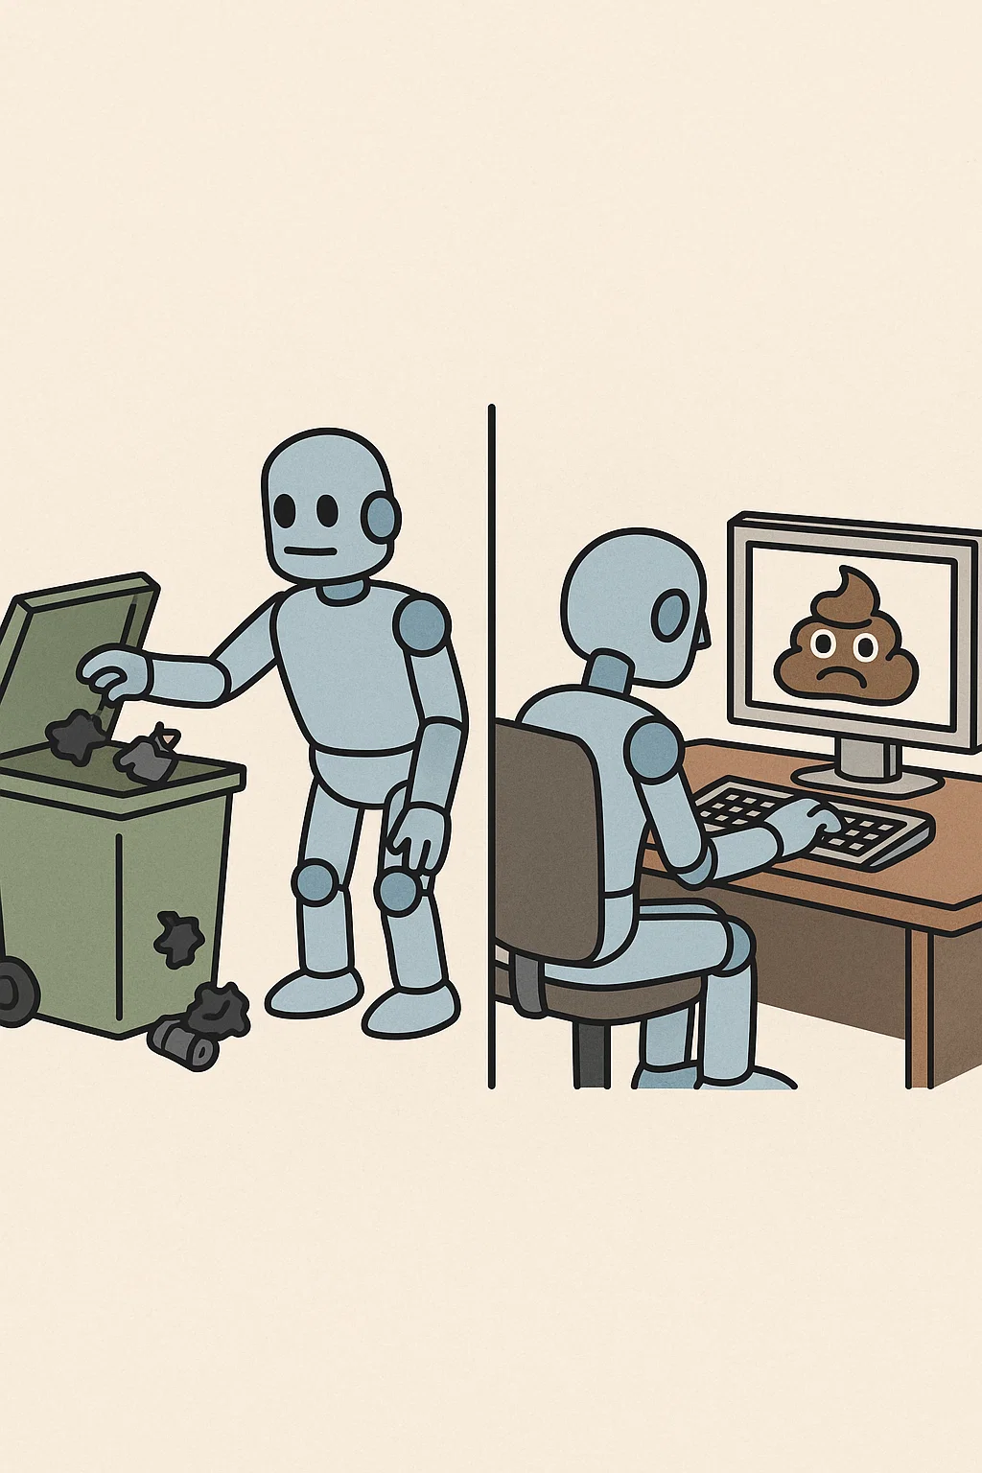
AI is a hammer,
not a craftsman
Experiments Need Constraints
Messy Input, Messy Output
Notes:
AI is a hammer
Think of AI as a powerful tool, it is as strong as the hand that’s holding it.
Copilot doesn't understand goals, context, or design principles. That’s still your job and you always drive the outcome.
Constraints are needed
Teams need to define what’s safe to try, where, and with what kinds of prompts.
You should follow contract-first development with specs, schemas, unit tests, etc.
Garbage in garbage out
The quality of the output is at large determined by the quality of your prompt.
If your comments are unclear or ambiguous you can get weird suggestions.

Slide 6



Expectations vs Reality
Use It Like a Junior, Not a Genius
Document As You Go
Notes:
Manage your expectations
Sometimes the suggestions look great but then when you run it you find out that edge cases are not covered, or even syntax errors. It helps to set ground rules for copilot and I will show you an example of that later.
New junior in the team
Treat copilot as a junior developer, it knows very well how to code but it doesn’t fully understand your system, your standards, business rules, etc
Copilot can and does make mistakes (interval timer example)
It needs structure, guidance, and review.
Documentation
Copilot can help you write code but it doesn’t know the why behind it.
I found that documenting intentions, edge cases, and prompt patterns as I went gave me more consistent results over time. It also helps explaining your project to a new joiner. Copilot is no different.

Slide 7



Beware Leaky Prompts
Let the Team Learn Together
Don’t Just Copilot. Code Review.
Notes:
Prompts:
It’s easy to forget that prompt inputs are not private.
We trained ourselves to avoid including internal IPs, or credentials in prompts.
Just like you wouldn’t post secrets to Stack Overflow, don’t put them in prompts.
Learning together:
- One of our biggest unlocks wasn’t technical, it was cultural.
There can be hesitation or even reluctance to using AI. It helped a lot to have guilds with monthly catch-ups.
Code review:
AI makes mistakes, creates bugs, and hallucinates. Probability goes higher with the size of your workspace.
It can be a good practice to tag Copilot commits and always review with human context in mind, not only reviewing syntax and correctness but does it fulfill the business requirement? Is there a better or safer why to implement it? Will it break something else? Does it follow the team conventions? Etc

Slide 8

Demo
https://github.com/akram0zaki/GithubCopilotDemo

Slide 9
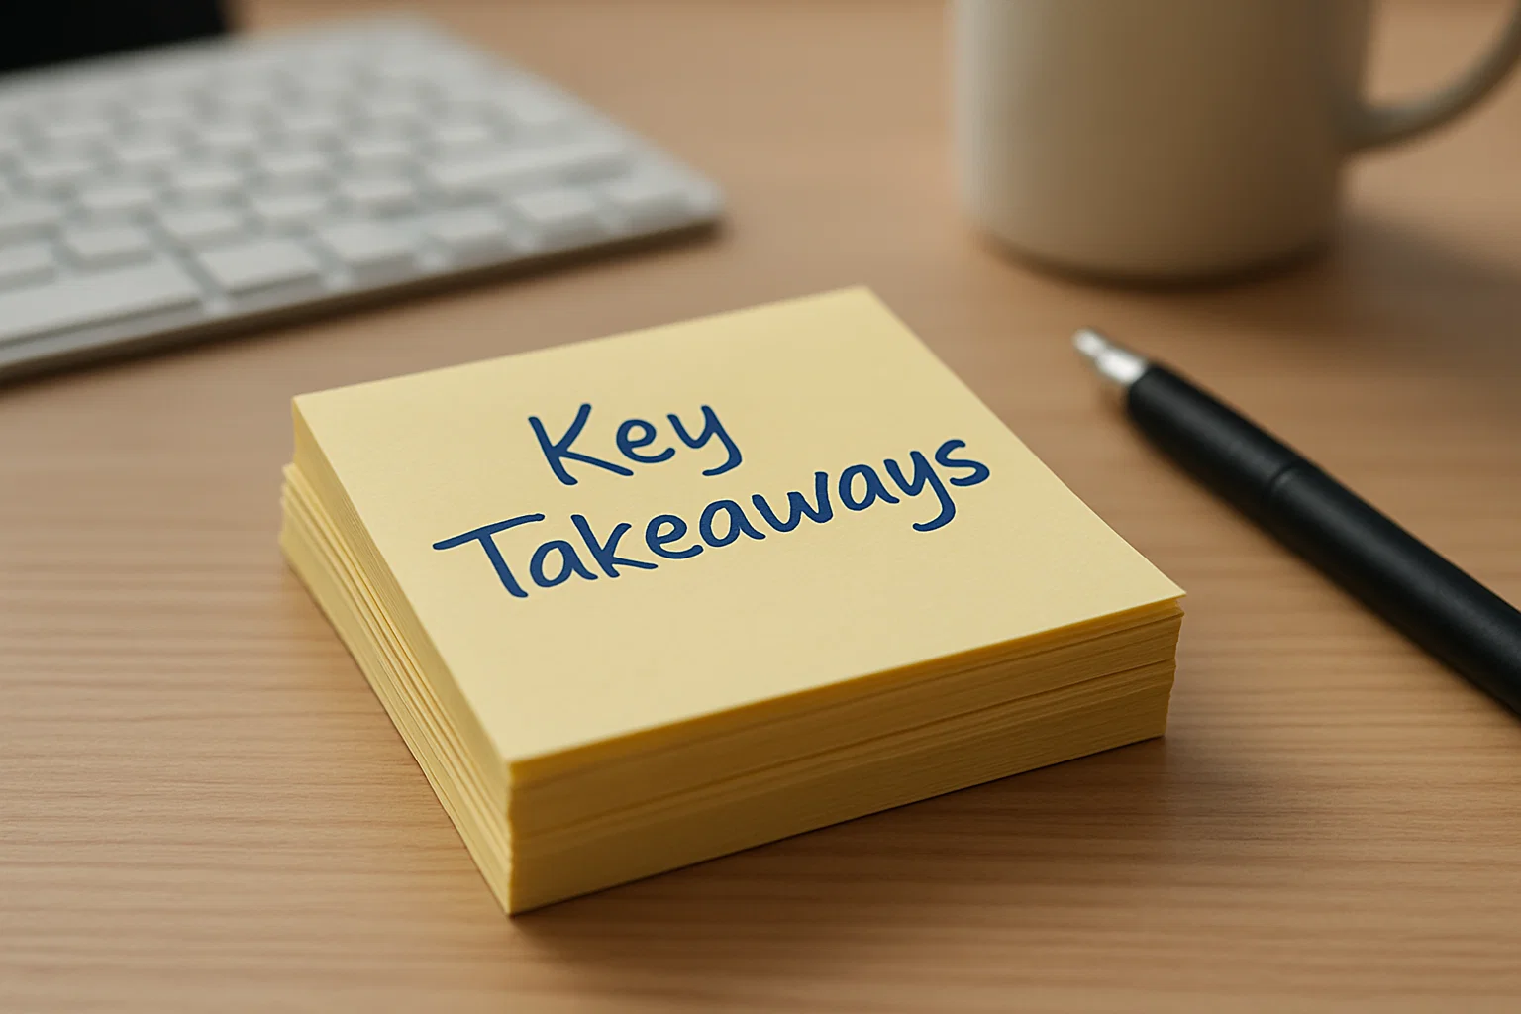
Key Takeaways

Slide 10

Adoption Is a Journey, Not a Switch
Copilot Is a Multiplier, Not a Replacement
Prompt Quality and Safe Use Are Core to Success
Boosting Productivity vs. Enablement
Tests Catch What Copilot Can't See
Feedback & Reviews Make Copilot Smarter and Safer
From Knowledge Workers to Agent Managers
Use Instructions to Enforce Governance

Slide 11


